Slide 1
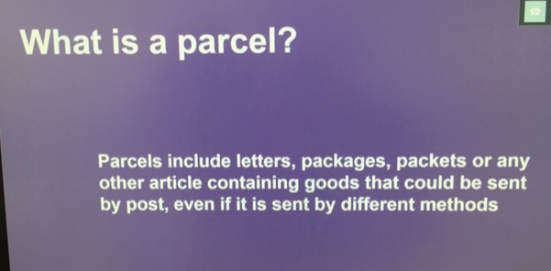
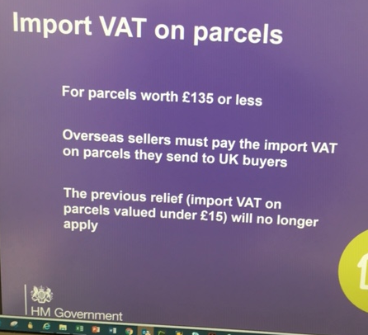
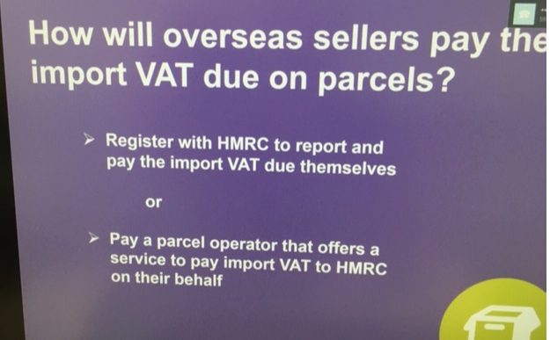
ECommerce after Brexit
Question:
What about duties, if applicable e.g. for apparel ?
Webinar „Preparing for Brexit“ HMRC 28.8.19

